Slide 1
CSE 4203 DISCRETE MATHEMATICS
Mohammad Ridwan Kabir (MRK) Email : ridwankabir@iut-dhaka.edu

Slide 2
Introduction
Contents
Discrete Mathematics and its applications-
7th edition – Kenneth H. Rosen
References and slides as provided in the class.
Quizzes and Assignments
6 quizzes ( 3 before mid + 3 after mid ). Best 3 will be counted.
Out of 6 quizzes, 4 will be scheduled and the rest will be surprise quizzes.
2 assignments will be given.

Slide 3
Chapter 1 The Foundations : Logic and Proofs Kenneth H. Rosen 7th edition
Section 1.1 : Propositional Logic

Slide 4
Propositios
A declarative sentence, i.e. declares a fact
Either true
Or false
But not both
Propositions | Not propositions
2+2=4 | What time is it?
2+2=3 | x+1=3
Dhaka is the capital of Bangladesh | x + y = z
Toronto is the capital of USA | Read this carefully

Slide 5
Propositional variables
Variables used to represent propositions
Example:
Donald is a good guy.
Rebecca is a talented girl.
Assigning variables to propositions:
p = “Donald is a good guy.”
q = “Rebecca is a talented girl.”
Most commonly used variables are p, q, r, s…
The truth values of a proposition is denoted by
T, if the proposition is true.
F, if the proposition is false.
We can also use the following convention
1, if the proposition is true.
0, if the proposition is false.

Slide 6
Propositional variables (contd.)
Converting sentences into propositions:
Consider the sentence, X+Y=Z
This is not a proposition.
The sentence contains variables only.
To convert this sentence into a proposition, we have to assign values to the variables.
Let’s say, X=2, Y=4, Z=6
Thus, X+Y=Z or 2+4=6 becomes a proposition as the outcome is true.
Again let’s say X=2,Y=4,Z=3
Again, X+Y=Z or 2+4=3 becomes a proposition as the outcome is false.

Slide 7
Propositional calculus/logic
Area of logic that deals with propositions, is called propositional calculus or propositional logic.

Slide 8
Compound Propositions
New propositions are formed by combining one or more propositions.
These are formed from existing propositions using logical operators
The newly formed propositions are termed as COMPOUND PROPOSITIONS.

Slide 9





Logical Operators
Logical Operators
Negation ( ¬ )
Exclusive Disjunction/ XOR ( $⨁$ )
Conjunction / AND ( $⋀$ )
Disjunction / OR ( $⋁$ )
Conditionals / Implications ( $→$)
Bi-conditionals ( $↔$ )

Slide 10

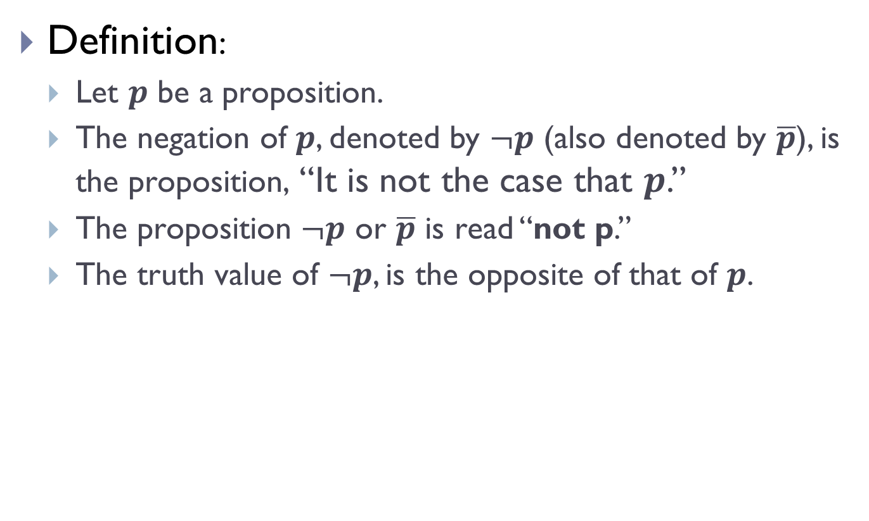
Negation Operator (¬)
Definition:
Let $p$ be a proposition.
The negation of $p$, denoted by $¬p$ (also denoted by $\overline{p}$), is the proposition, “It is not the case that $p$.”
The proposition $¬p$ or $\overline{p}$ is read “not p.”
The truth value of $¬p$, is the opposite of that of $p$.
$$p$$ | $$\overline{p}$$
T | F
F | T

Slide 11
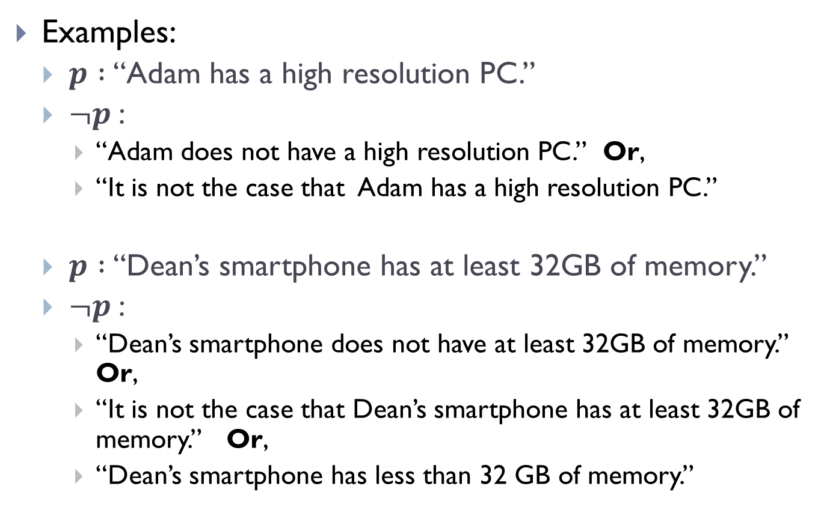
Negation Operator (¬) (contd.)
Examples:
$p :$“Adam has a high resolution PC.”
$¬p$:
“Adam does not have a high resolution PC.” Or,
“It is not the case that Adam has a high resolution PC.”
$p :$“Dean’s smartphone has at least 32GB of memory.”
$¬p$:
“Dean’s smartphone does not have at least 32GB of memory.” Or,
“It is not the case that Dean’s smartphone has at least 32GB of memory.” Or,
“Dean’s smartphone has less than 32 GB of memory.”

Slide 12
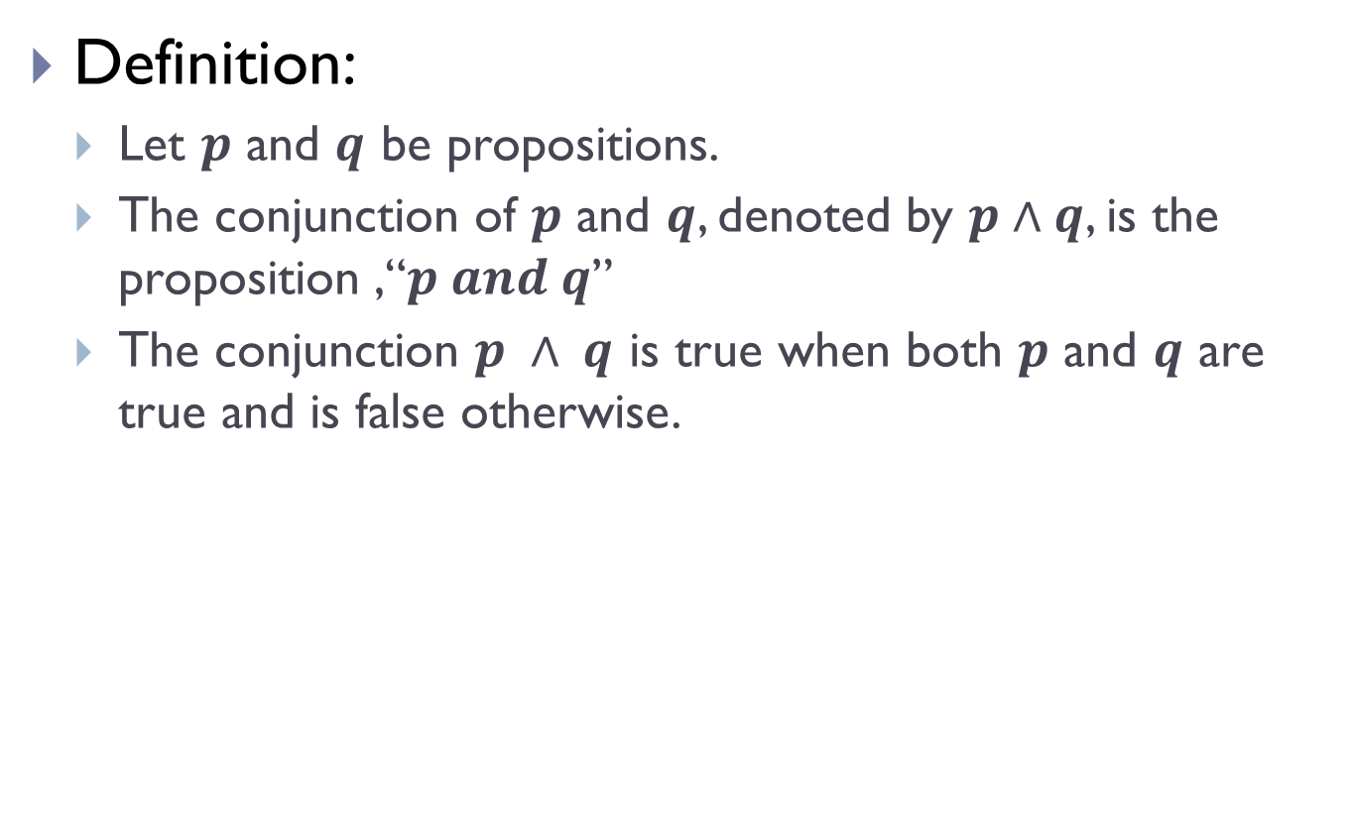
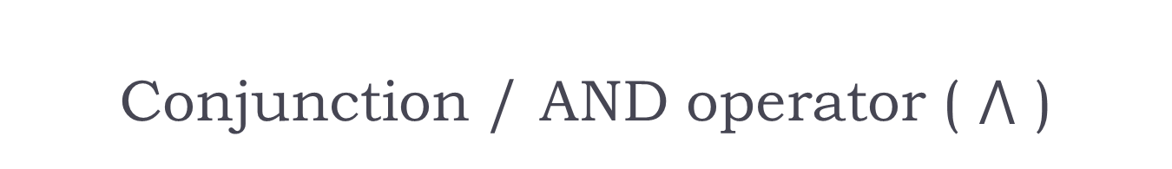
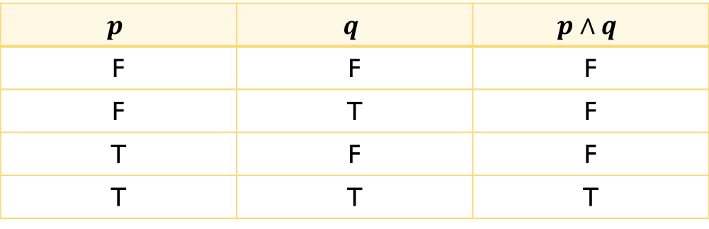
Conjunction / AND operator ( $⋀$ )
Definition:
Let $p$ and $q$ be propositions.
The conjunction of $p$ and $q$, denoted by $p∧q$, is the proposition ,“$p and q$”
The conjunction $p ∧ q$ is true when both $p$ and $q$ are true and is false otherwise.
$$p$$ | $$q$$ | $$p∧q$$
F | F | F
F | T | F
T | F | F
T | T | T

Slide 13
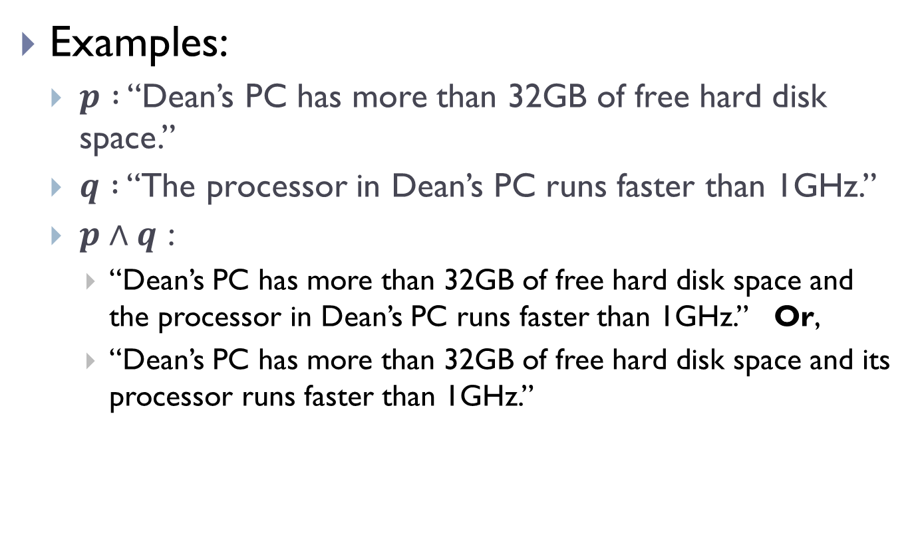
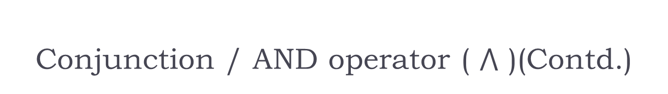
Conjunction / AND operator ( $⋀$ )(Contd.)
Examples:
$p :$ “Dean’s PC has more than 32GB of free hard disk space.”
$q :$ “The processor in Dean’s PC runs faster than 1GHz.”
$p∧q$ :
“Dean’s PC has more than 32GB of free hard disk space and the processor in Dean’s PC runs faster than 1GHz.” Or,
“Dean’s PC has more than 32GB of free hard disk space and its processor runs faster than 1GHz.”

Slide 14
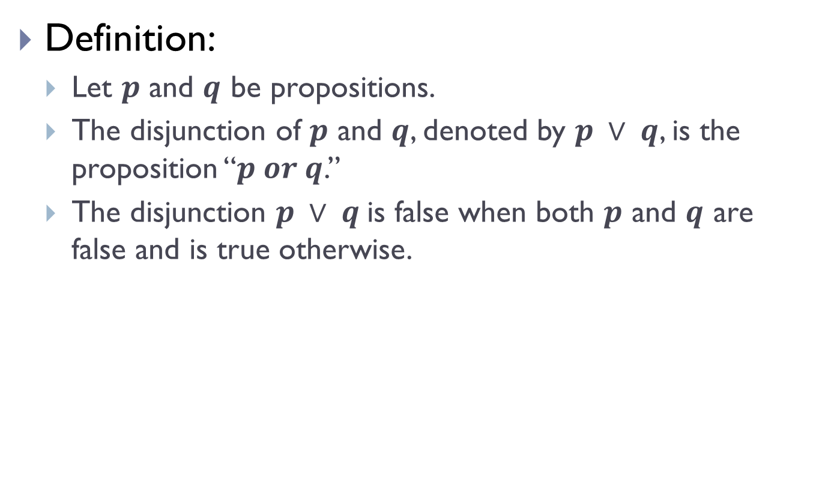


Disjunction / OR operator ( $∨$ )
Definition:
Let $p$ and $q$ be propositions.
The disjunction of $p$ and $q$, denoted by $p ∨ q$, is the proposition “$p or q$.”
The disjunction $p ∨ q$is false when both $p$ and $q$ are false and is true otherwise.
$$p$$ | $$q$$ | $$p∨q$$
F | F | F
F | T | T
T | F | T
T | T | T

Slide 15
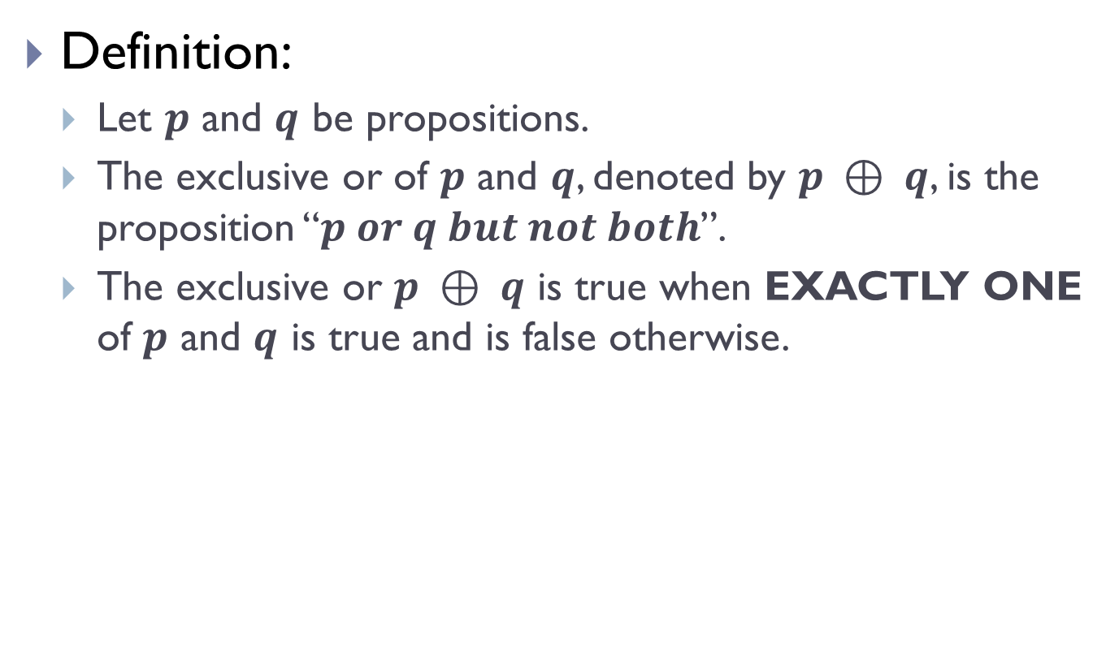

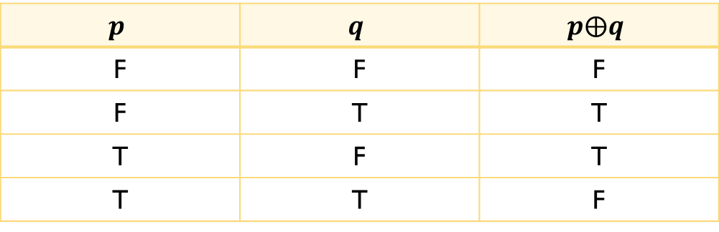
Exclusive OR/ XOR operator ( $⨁$ )
Definition:
Let $p$ and $q$ be propositions.
The exclusive or of $p$ and $q$, denoted by $p ⊕ q$, is the proposition “$p or q but not both$”.
The exclusive or $p ⊕ q$ is true when EXACTLY ONE of $p$ and $q$ is true and is false otherwise.
$$p$$ | $$q$$ | $$p⨁q$$
F | F | F
F | T | T
T | F | T
T | T | F

Slide 16
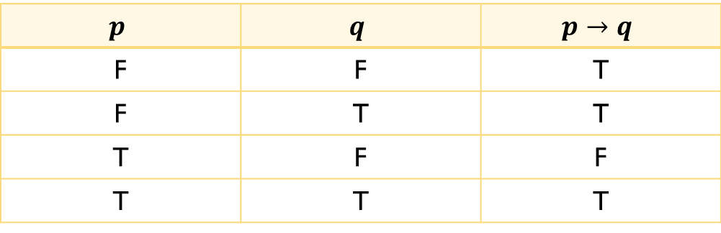
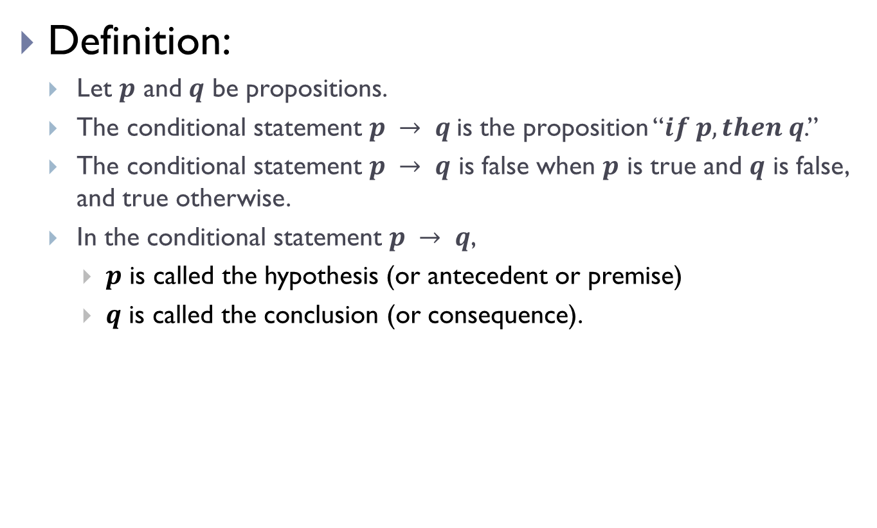
Conditionals/Implications
Definition:
Let $p$ and $q$ be propositions.
The conditional statement $p → q$is the proposition “$if p, then q$.”
The conditional statement $p → q$ is false when $p$ is true and $q$ is false, and true otherwise.
In the conditional statement $p → q$,
$p$ is called the hypothesis (or antecedent or premise)
$q$ is called the conclusion (or consequence).
$$p$$ | $$q$$ | $$p→q$$
F | F | T
F | T | T
T | F | F
T | T | T

Slide 17
Conditionals/Implications(Contd.)
Terminologies to express implication:
“if p, then q”
“p implies q”
“if p, q”
“p only if q”
“p is sufﬁcient for q”
“a sufﬁcient condition for q is p”
“q if p”
“q whenever p”
“q when p”
“q is necessary for p”
“a necessary condition for p is q”
“q follows from p”
“q unless ¬p”

Slide 18
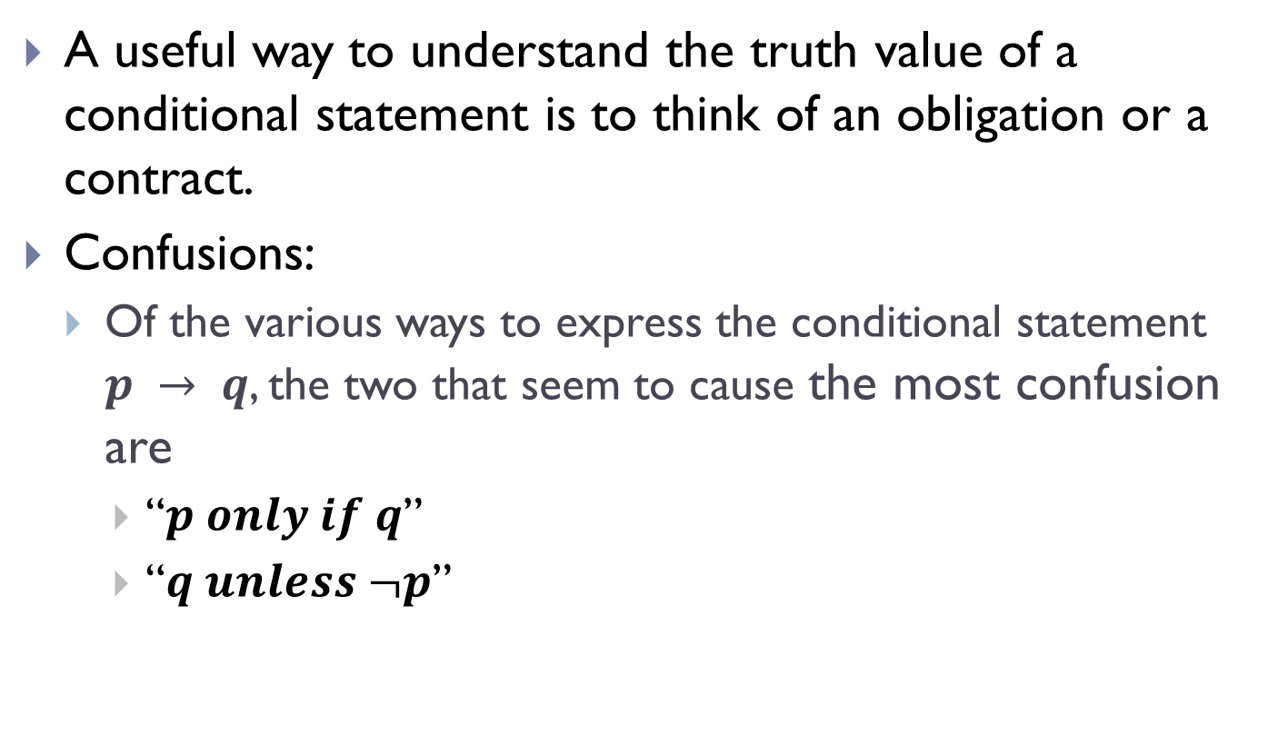
Conditionals/Implications(Contd.)
A useful way to understand the truth value of a conditional statement is to think of an obligation or a contract.
Confusions:
Of the various ways to express the conditional statement $p → q$, the two that seem to cause the most confusion are
“$p only if q$”
“$q unless ¬p$”

Slide 19
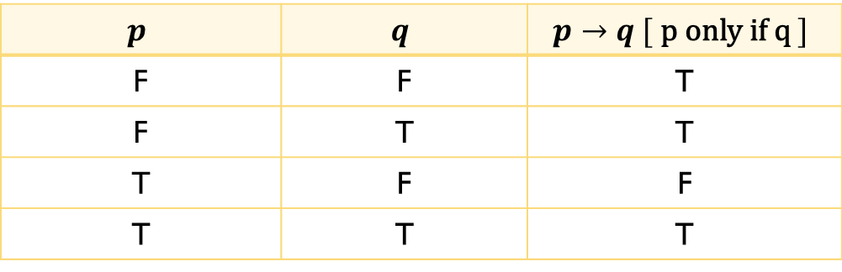
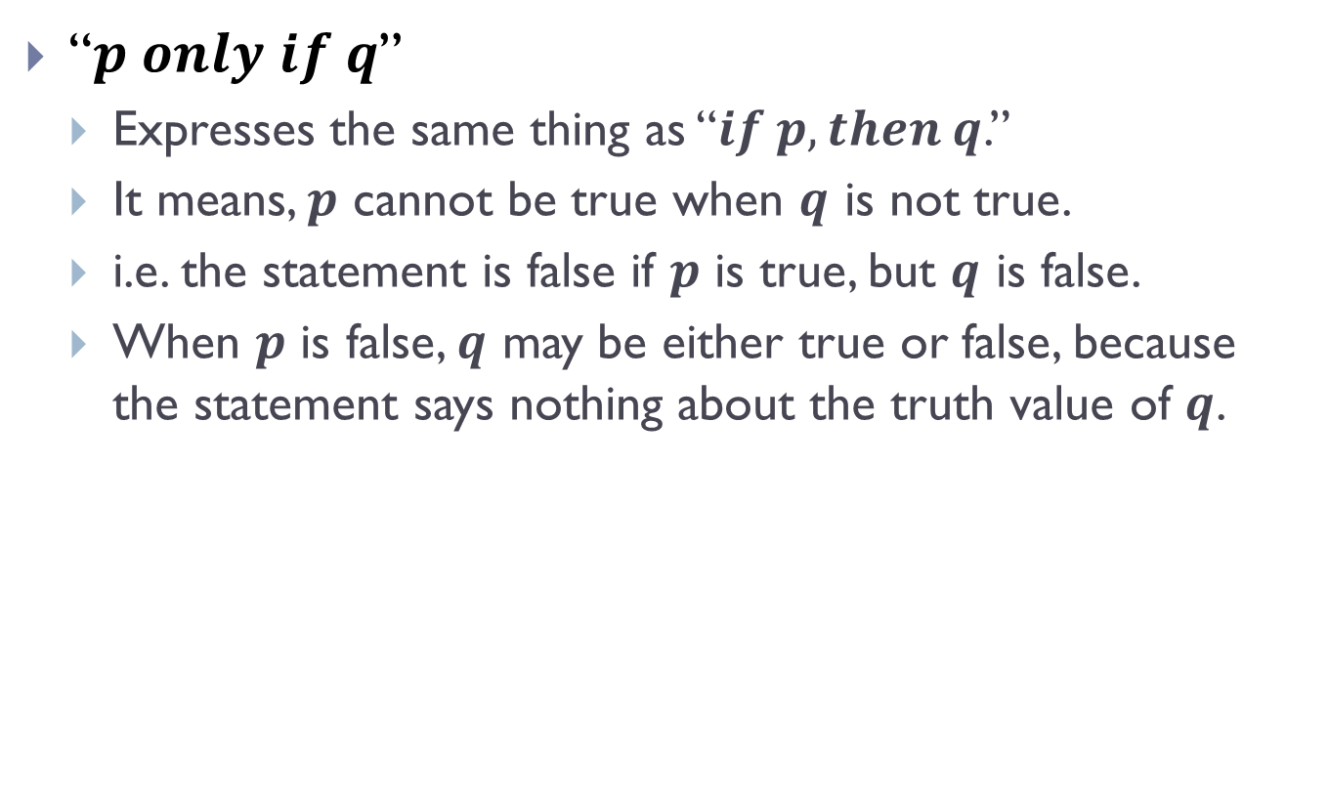
Conditionals/Implications(Contd.)
“$p only if q$”
Expresses the same thing as “$if p, then q$.”
It means, $p$ cannot be true when $q$ is not true.
i.e. the statement is false if $p$ is true, but $q$ is false.
When $p$ is false, $q$ may be either true or false, because the statement says nothing about the truth value of $q$.
$$p$$ | $$q$$ | $$p→q [ \text{p} \text{only} \text{if} \text{q} ]$$
F | F | T
F | T | T
T | F | F
T | T | T

Slide 20
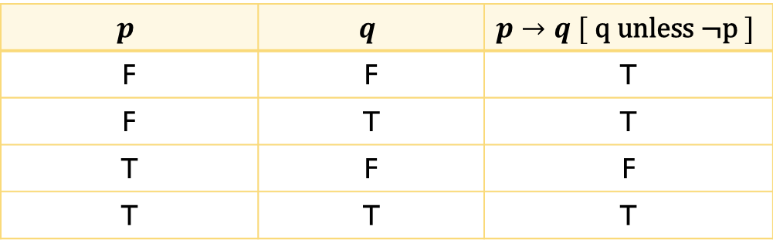
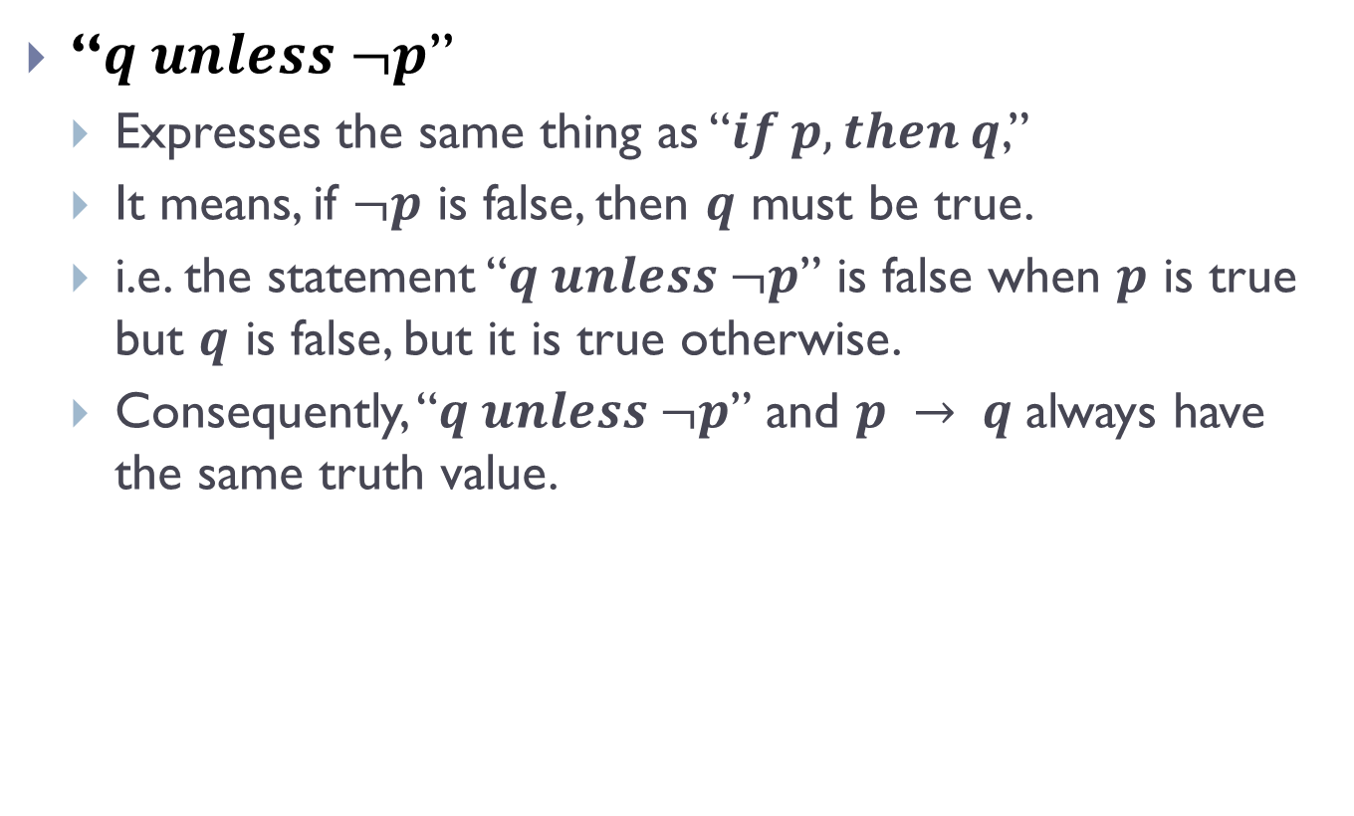
Conditionals/Implications(Contd.)
“$q unless ¬p$”
Expresses the same thing as “$if p, then q$,”
It means, if $¬p$ is false, then $q$ must be true.
i.e. the statement “$q unless ¬p$” is false when $p$ is true but $q$ is false, but it is true otherwise.
Consequently, “$q unless ¬p$” and $p → q$always have the same truth value.
$$p$$ | $$q$$ | $$p→q [ \text{q} \text{unless}\text{ ¬}\text{p} ]$$
F | F | T
F | T | T
T | F | F
T | T | T

Slide 21
Conditionals/Implications(Contd.)
Example:
p : “Maria learns discrete mathematics”
q : “Maria will ﬁnd a good job.”
Express the statement p → q as a statement in English.

Slide 22
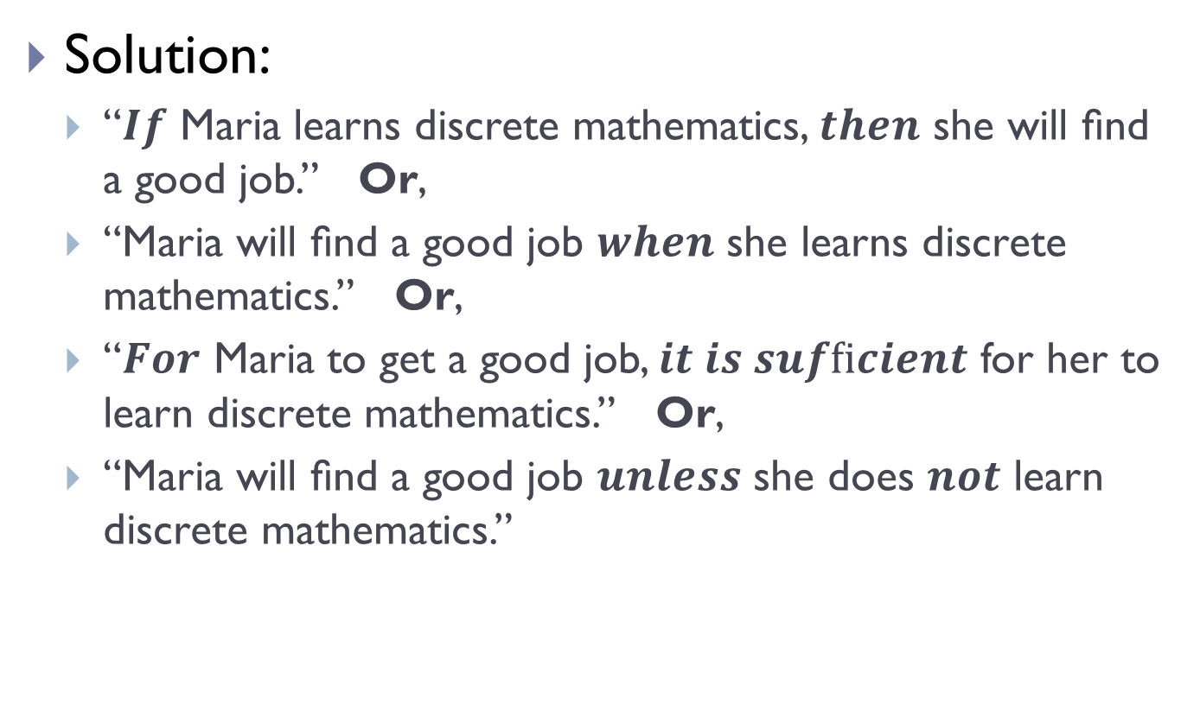
Conditionals/Implications(Contd.)
Solution:
“$If$ Maria learns discrete mathematics, $then$ she will ﬁnd a good job.” Or,
“Maria will ﬁnd a good job $when$ she learns discrete mathematics.” Or,
“$For$ Maria to get a good job, $it is sufﬁcient$ for her to learn discrete mathematics.” Or,
“Maria will ﬁnd a good job $unless$ she does $not$ learn discrete mathematics.”

Slide 23
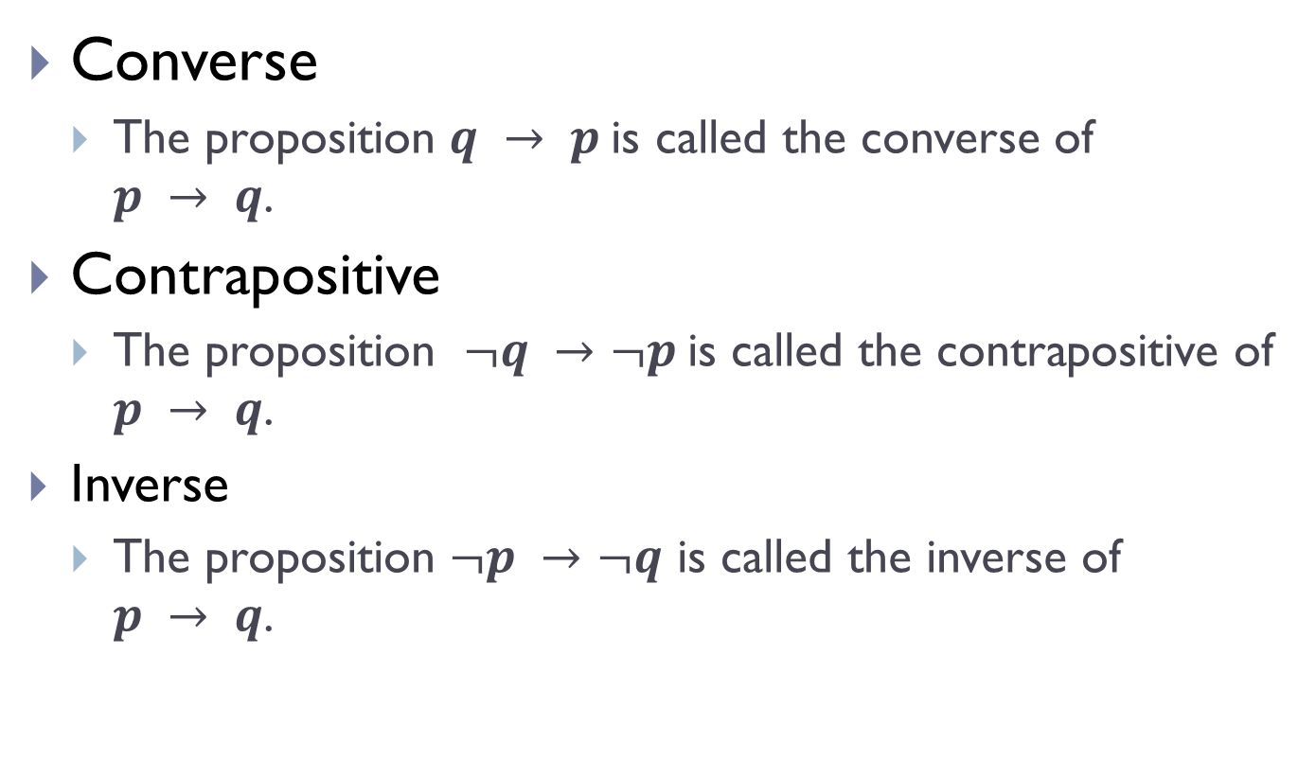
Converse, Contrapositive and Inverse
Converse
The proposition $q → p$is called the converse of $p → q$.
Contrapositive
The proposition $¬q →¬p$is called the contrapositive of $p → q$.
Inverse
The proposition $¬p →¬q$ is called the inverse of $p → q$.

Slide 24
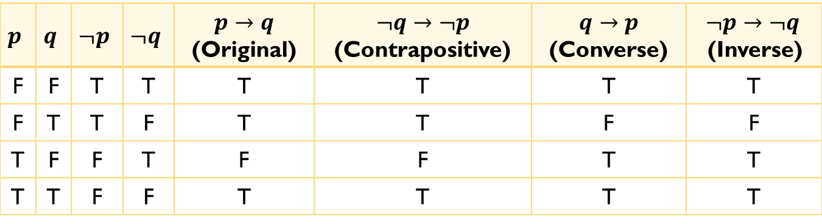
Converse, Contrapositive and Inverse(Contd.)
$$p$$ | $$q$$ | $$¬p$$ | $$¬q$$ | $$p→q$$ (Original) | $$¬q→¬p$$ (Contrapositive) | $$q→p$$ (Converse) | $$¬p→¬q$$ (Inverse)
F | F | T | T | T | T | T | T
F | T | T | F | T | T | F | F
T | F | F | T | F | F | T | T
T | T | F | F | T | T | T | T

Slide 25
Converse, Contrapositive and Inverse(Contd.)
Equivalence:
When two compound propositions always have the same truth value we call them equivalent.
The original conditional statement and its contrapositive are equivalent.
The converse and the inverse of a conditional statement are also equivalent, but neither is equivalent to the original conditional statement.

Slide 26
Converse, Contrapositive and Inverse(Contd.)
Example:
“The home team wins whenever it is raining?”
Find the converse, contrapositive and inverse of the aforementioned statement.

Slide 27
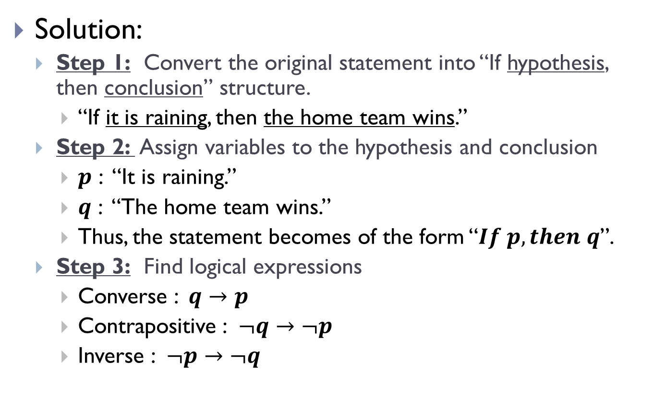
Converse, Contrapositive and Inverse(Contd.)
Solution:
Step 1: Convert the original statement into “If hypothesis, then conclusion” structure.
“If it is raining, then the home team wins.”
Step 2: Assign variables to the hypothesis and conclusion
$p$ : “It is raining.”
$q$ : “The home team wins.”
Thus, the statement becomes of the form “$If p, then q$”.
Step 3: Find logical expressions
Converse : $q→p$
Contrapositive : $¬q→¬p$
Inverse : $¬p→¬q$

Slide 28
Converse, Contrapositive and Inverse(Contd.)
Solution(Contd.):
Step 4: Assign values to the variables.
Converse:
“If the home team wins, then it is raining.”
Contrapositive:
“If the home team does not win, then it is not raining.”
Inverse:
“If it is not raining, then the home team does not win.”

Slide 29

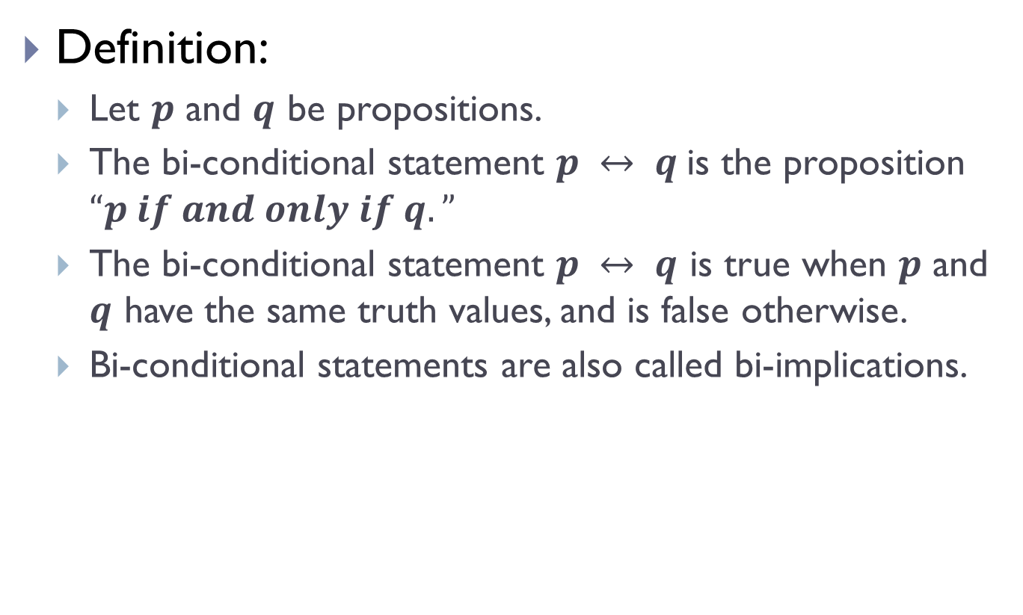
Bi-conditionals
Definition:
Let $p$ and $q$ be propositions.
The bi-conditional statement $p ↔ q$is the proposition $“p if and only if q.”$
The bi-conditional statement $p ↔ q$ is true when $p$ and $q$ have the same truth values, and is false otherwise.
Bi-conditional statements are also called bi-implications.
$$p$$ | $$q$$ | $$p↔q$$
F | F | T
F | T | F
T | F | F
T | T | T

Slide 30
Bi-conditionals(Contd.)
Terminologies to express bi-conditionals:
“p if and only if q.”
“p is necessary and sufﬁcient for q”
“if p then q, and conversely”
“p iff q.”

Slide 31
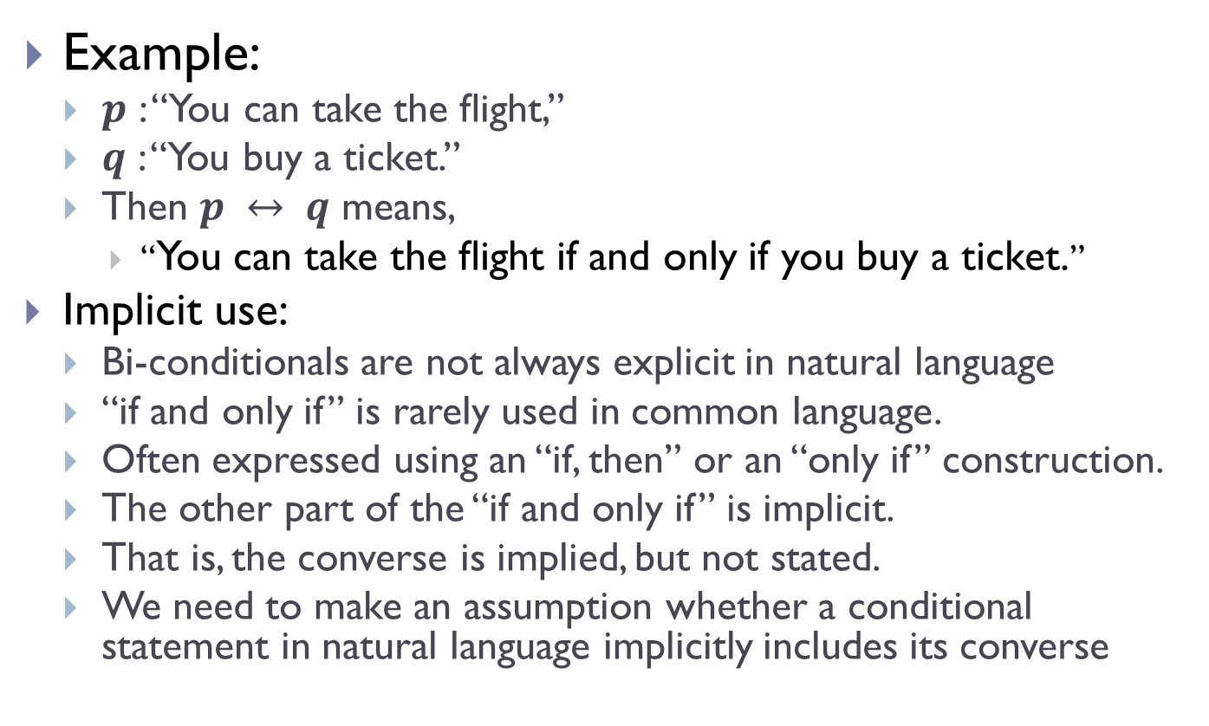
Bi-conditionals(Contd.)
Example:
$p$ : “You can take the ﬂight,”
$q$ : “You buy a ticket.”
Then $p ↔ q$ means,
“You can take the ﬂight if and only if you buy a ticket.”
Implicit use:
Bi-conditionals are not always explicit in natural language
“if and only if” is rarely used in common language.
Often expressed using an “if, then” or an “only if” construction.
The other part of the “if and only if” is implicit.
That is, the converse is implied, but not stated.
We need to make an assumption whether a conditional statement in natural language implicitly includes its converse

Slide 32
Bi-conditionals(Contd.)
Example of Implicit Use:
“If you ﬁnish your meal, then you can have dessert.”
What it really means:
“You can have dessert if and only if you ﬁnish your meal.”
This last statement is logically equivalent to the two statements
“If you ﬁnish your meal, then you can have dessert” And,
“You can have dessert only if you ﬁnish your meal.”

Slide 33
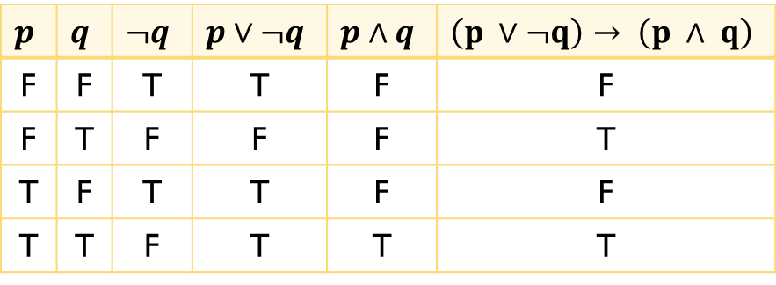
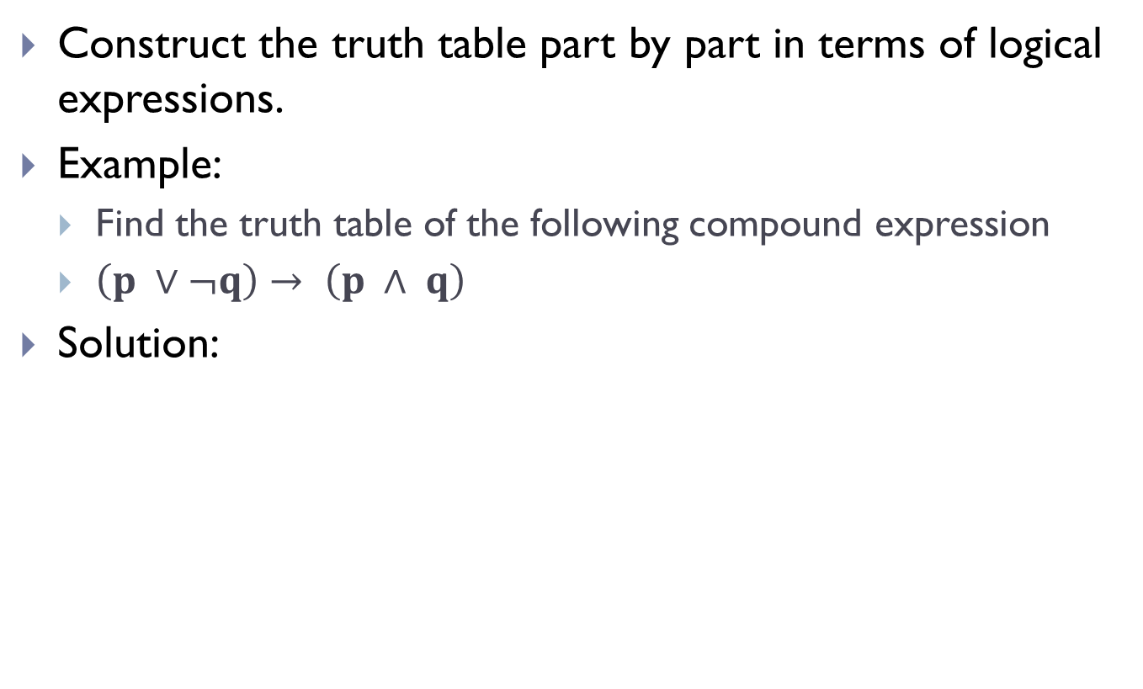
Truth table of compound propositions
Construct the truth table part by part in terms of logical expressions.
Example:
Find the truth table of the following compound expression
$\left(p ∨¬q\right)→ \left(p ∧ q\right)$
Solution:
$$p$$ | $$q$$ | $$¬q$$ | $$p∨¬q$$ | $$p∧q$$ | $$\left(p ∨¬q\right)→ \left(p ∧ q\right)$$
F | F | T | T | F | F
F | T | F | F | F | T
T | F | T | T | F | F
T | T | F | T | T | T

Slide 34
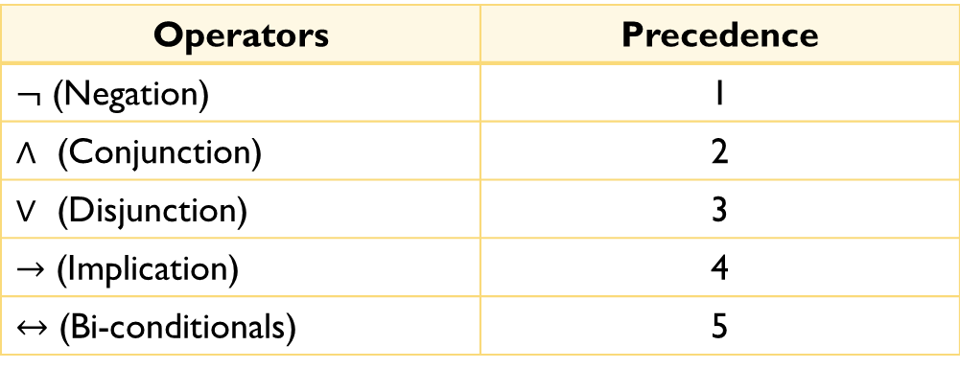
Precedence of Logical Operators
The operators with lower precedence values have higher priorities.
That means, the operation of those operators must be performed before that of the low priority operators.
Operators | Precedence
$¬$ (Negation) | 1
$∧$ (Conjunction) | 2
$∨$ (Disjunction) | 3
$→$ (Implication) | 4
$↔$ (Bi-conditionals) | 5

Slide 35
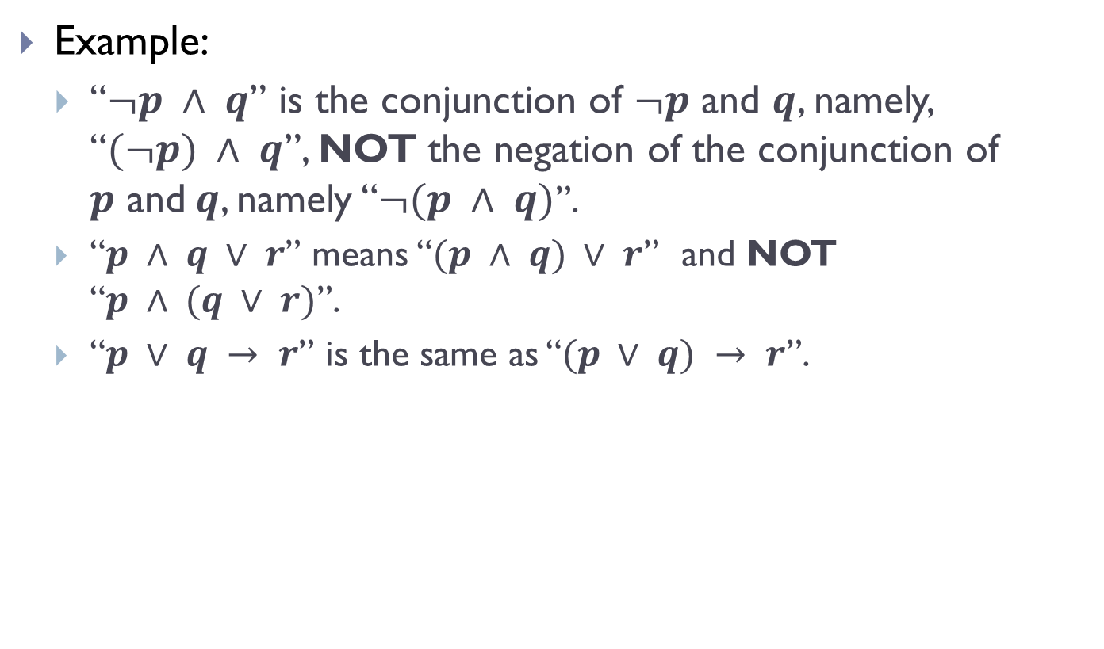
Precedence of Logical Operators(Contd.)
Example:
“$¬p ∧ q$” is the conjunction of $¬p$ and $q$, namely, “$(¬p) ∧ q$”, NOT the negation of the conjunction of $p$ and$q$, namely “$¬(p ∧ q)$”.
“$p ∧ q ∨ r$” means “$(p ∧ q) ∨ r$” and NOT “$p ∧ (q ∨ r)$”.
“$p ∨ q → r$” is the same as “$(p ∨ q) → r$”.

Slide 36
Logic and Bit Operations
A bit is a symbol with two possible values,
0 (zero)
1 (one)
A bit can be used to represent a truth value, because there are two truth values,
True (T)
False (F)
1 (one) represents T (true).
0 (zero) represents F (false).

Slide 37
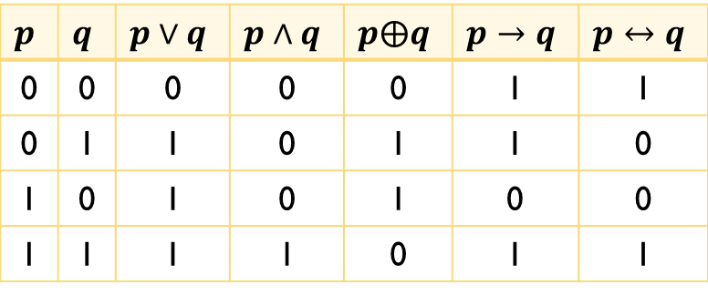
Logic and Bit Operations(Contd.)
Logical operations using 1s (Ones) and 0s (Zeros)
$$p$$ | $$q$$ | $$p∨q$$ | $$p∧q$$ | $$p⨁q$$ | $$p→q$$ | $$p↔q$$
0 | 0 | 0 | 0 | 0 | 1 | 1
0 | 1 | 1 | 0 | 1 | 1 | 0
1 | 0 | 1 | 0 | 1 | 0 | 0
1 | 1 | 1 | 1 | 0 | 1 | 1

Slide 38
Logic and Bit Operations(Contd.)
Bit Strings
A bit string is a sequence of zero or more bits.
The length of this string is the number of bits in the string.
101010011 is a bit string of length nine.
We can extend bit operations to bit strings.
We deﬁne the bitwise OR, bitwise AND, and bitwise XOR of two strings of the same length to be the strings that have as their bits, the OR,AND, and XOR of the corresponding bits in the two strings, respectively.
We will split bit strings into blocks of four bits to make them easier to read.

Slide 39
Logic and Bit Operations(Contd.)
Example:
Find the bitwise OR, bitwise AND, and bitwise XOR of the bit strings 01 1011 0110 and11 0001 1101.
01 1011 0110 | String 1
11 0001 1101 | String 2
11 1011 1111 | Bitwise OR
01 0001 0100 | Bitwise AND
10 1010 1011 | Bitwise XOR

Slide 40
THE END

